Slide 1
Calculation Statements
Add, Subtract, Multiply, Divide & Calculate statements

Slide 2
OBJECTIVES
COBOL Arithmetic statements
  ADD
  SUBTRACT
  MULTIPLY
  DIVIDE
  COMPUTE
COBOL data class
DISPLAY of edited pictures

Slide 3
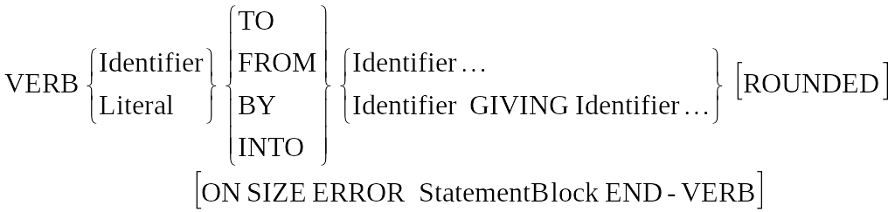
ARITHMETIC Verb TEMPLATE
Most COBOL arithmetic verbs conform to the template above
ADD SALES-AMOUNT TO TOTAL-ORDER
ADD RETAIL-SALES TO SALES-TAX GIVING SALE-TOTAL
ADD ENTRY-A ENTRY-B ENTRY-C GIVING FINAL-TOT ROUNDED
SUBTRACT SALES-TAX FROM TOTAL-SALE
SUBTRACT TAX FROM GROSS-PAY GIVING NET-PAY
MULTIPLY UNIT-RATE BY TOT-ITEMS GIVING TOTAL-SALE
MULTIPLY 20 BY MAGNITUDE
DIVIDE TOTAL-RUNS BY OVERS GIVING AVERAGE
DIVIDE OVERS INTO TOTAL-RUNS GIVING AVERAGE

Slide 4
ARITHMETIC Verb
ROUNDED OPTION
  The ROUNDED OPTION take effect when, after decimal point alignment, the result calculated must be truncated on the right hand side
  The option adds 1 to the receiving item when the leftmost truncated digit has an absolute value of 5 or greater
  e.g. If receiving field is 9(3)V99 and actual result is 789.567 then Rounded result will be 789.57

Slide 5
ARITHMETIC Verb
ON SIZE ERROR OPTION
  If the value of an arithmetic evaluation exceeds the largest value that can be contained in a result then a size error condition exists
  The SIZE ERROR condition applies to final result and not an intermediate calculations
  If ON SIZE ERROR is not specified then truncation of the results will occur
  If ON SIZE ERROR phrase is specified, the imperative statement is taken, following which control is transferred to end of arithmetic statement

Slide 6
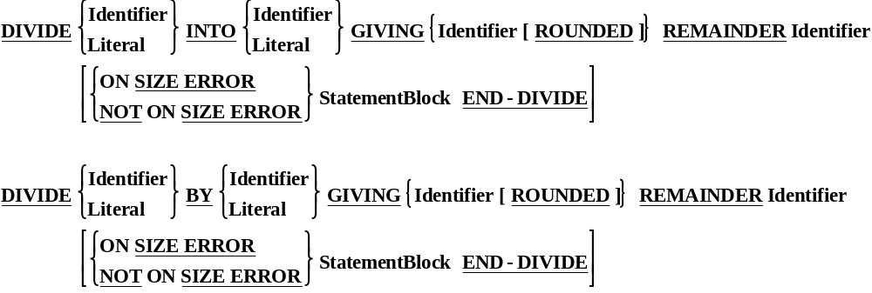
DIVIDE Syntax (REMAINDER)
DIVIDE 109 BY 5 GIVING Quotient REMAINDER Remain
21 4
ON SIZE ERROR MOVE 'INVALID DIVIDE' TO ERROR-MESSAGE
END-DIVIDE

Slide 7

COMPUTE Statement
Precedence of operation will be in order of Power (**), Divide/Mulitply, Add/Subtract
COMPUTE V = U + A*T

Slide 8
Classes Of Data
Group Items are in ALPHANUMERIC class regardless of subordinate items
Elementary items are in a class determined by their definitions (PIC clause)
  Alphabetic (A)
  Numeric (9, P, S, V)
  Numeric Edited (B, P, V, Z, 9, 0,/,., +, -, CR,DB,*,$)
  Alphanumeric (X or X with A 9)
  Alphanumeric Edited (A, X, 9, B, 0, /)

Slide 9
EDITED PICTURES
Edited Pictures are PICTURE clauses which formats data intended for output to screen or printer
To enable data items to be formatted in a particular style, COBOL provides additional picture symbols supplementing the basic 9,X,A, V & S symbols
The additional symbols are referred as ‘Edit Symbols’ and PIC clause which include Edited symbols are referred to as ‘Edited Pictures’
The term Edit is used because the edit symbols have the effect of changing or editing the data inserted into Edited item
Edited items can not be used as operands in computation but may be used as the result or a destination of a computation (i.e. right to the word of GIVING)

Slide 10
Editing
INSERTION EDITING
Value Of Data
COBOL PICTURE
Edited Result
0
99999.99
00000.00
1234
99999.99
01234.00
0.3456
99999.99
00000.34
12345
99,999.99
12,345.00
12345-
99999.99
12345.00
123^45
99999.99
00123.45

Slide 11
Editing (Contd..)
ZERO SUPPRESION EDITING
Value Of Data
COBOL PICTURE
Edited Result
0
ZZZZZ.99
.00
1234
ZZZZZ.99
1234.00
12345
ZZ,ZZZ.ZZ
12,345
123-
-ZZZZZ.99
- 123.00
123.456
ZZZZZ.99
123.45

Slide 12
Editing (Contd..)
FIXED INSERTION EDITING
Value Of Data
COBOL PICTURE
Edited Result
0
$9999.99
$0000.00
1234
$9999.99
$1234.00
1234-
$9999.99CR
$1234.00 CR
12345
$99,999.99
$12,345.00
123^45-
$99,999.99-
$00,123.45-
123^45-
-$99,999.99
-$00,123.45

Slide 13
Editing (Contd..)
FLOATING INSERTION EDITING
Value Of Data
COBOL PICTURE
Edited Result
0
$$$$$.99
$.00
0
$$$$9.99
$0.00
4678
**999
*4678
123
$$$$$.99
$123.00
12345
$$$$$.99
$2345.00
12345
$$$,$$$.99-
$12,345.00
123^45-
$$,$$$.99-
$123.45-

Slide 14
COBOL Conditional Statements
IF statements, Simple Conditions, Complex Conditions, Condition Names, Evaluate statement, Continue statement

Slide 15
OBJECTIVES
Introduction to Relational Expressions
Introduction to IF statements
  Class conditions
  Sign conditions
  Complex Conditions
  Condition Names
EVALUATE statement
EVALUATE-ALSO & EVALUATE-ANY statement
CONTINUE Statement

Slide 16
Relational Expressions
Relational tests (comparisons) can be expressed as:
  IS LESS THAN <
  IS NOT LESS THAN NOT <
  IS GREATER THAN >
  IS NOT GREATER THAN NOT>
  IS EQUAL TO =
  IS NOT EQUAL TO NOT=
  IS GREATER THAN OR EQUAL TO >=
  IS LESS THAN OR EQUAL TO <=
The words IS, THAN & TO are not required
Combined symbols <= & >= do not contain any space or Comma between them

Slide 17
IF Statement
IF statement evaluates a condition and provides for alternative action in the object program depending on the evaluation
IF condition THEN {Statement Block/NEXT SENTENCE}
ELSE {Statement Block/NEXT SENTENCE}
[END-IF]
Condition Could be one of the following three types
  Simple Conditions (Relational, Class, Sign)
  Complex Conditions
  Condition Names
IF NEXT SENTENCE phrase is specified, it passes control to the statement after the closest following period

Slide 18
Class Condition
Following are the examples of Class Conditions:
  Identifier IS NOT NUMERIC
  Identifier IS ALPHABETIC
  Identifies IS ALPHABETIC-UPPER / ALPHABETIC-LOWER
Although COBOL data items are not ‘typed’ they do fall into broad categories or classes such as Numeric, Alphanumeric etc..
A Class condition determines if the value of data item is a member of one of these classes

Slide 19
Sign Conditions
Following are the examples of Sign Conditions:
  ArithExp is POSITIVE/NEGATIVE
  ArithExp is NOT ZERO
The Sign condition determines if the value of arithmetic expression is less than, greater than or equal to zero
Sign conditions are just another way of writing relational expressions

Slide 20
Complex Conditions
Programs often require condition which are more complex than single value testing or determining a data class
Conditional Expressions can be ‘Complex’ using the AND and OR logical operators
A Complex Condition is an expression which is evaluated from left to right unless the order of evaluation is changed by precedence rule or bracketing
Precedence rules are in order of NOT, AND and OR
  IF (COLUMN>7) AND (COLUMN<=11)
    DISPLAY “AREA A ON SCREEN’’
  END-IF.

Slide 21
Condition Names
Whenever a condition can occur, such as in IF statement or EVALUATE statement or PERFORM..UNTIL statement, a Condition Name (Level 88) may be used
A Condition Name is essentially a BOOLEAN variable which is either TRUE or FALSE
e.g. IF END-OF-FILE THEN
Condition Names are defined in Data Division using special level 88
Value of Condition Name can be changed using SET verb
READ Infile
      AT END SET END-OF-FILE TO TRUE

Slide 22
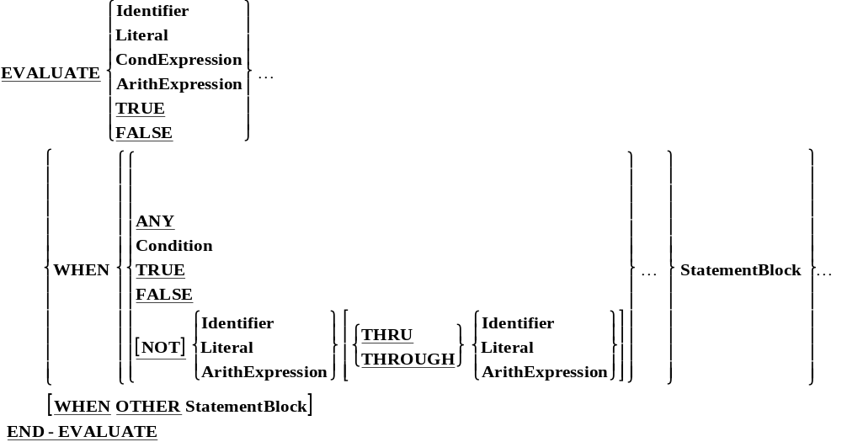
EVALUATE Statement
EVALUATE statement provides a shorthand notion of for a series of NESTED IF statements. It can evaluate multiple IF conditions

Slide 23
EVALUATE Statement (Contd..)
EVALUATE trans-id
WHEN ‘A’ PERFORM Add-trans
WHEN ‘D’ PERFORM Delete-trans
WHEN ‘U’
WHEN ‘W’ PERFORM Update-trans
WHEN OTHER PERFORM Bad-trans
END-EVALUATE
Reserved word TRUE or FALSE can also be used instead of Identifier or Expression as shown in the construct

Slide 24
EVALUATE Statement & ‘ALSO’
One may EVALUATE multiple test
  Each test must be separated from others by ‘ALSO’
  The Corresponding WHEN’s must contain the SAME NUMBER of comparands, also separated by ‘ALSO’
  ALSO plays a role of logical AND
  EVALUATE co-type ALSO co-size ALSO co-color
  WHEN ‘1’ ALSO ‘BIG’ ALSO ‘BLUE’
  PERFORM FOUND-IBM
  WHEN ‘2’ ALSO ‘TALL’ ALSO ‘RED’
  PERFORM FOUND-COMETS
  WHEN’3’ ALSO ‘TALL’ ALSO ‘BLUE’
  PERFORM FOUND-LIBERTY

Slide 25
EVALUATE Statement & ‘ANY’
‘ANY’ specifies any value is accepted for the test
EVALUATE co-type ALSO co-size ALSO co-color
  WHEN ‘1’ ALSO ‘BIG’ ALSO ANY
  PERFORM FOUND-IBM
  WHEN ‘2’ ALSO ‘TALL’ ALSO ‘RED’
  PERFORM FOUND-COMETS
  WHEN’3’ ALSO ‘TALL’ ALSO ‘BLUE’
  PERFORM FOUND-LIBERTY
  END-EVALUATE
Maximum 256 WHEN clauses are allowed per EVALUATE statement
Maximum 63 ALSO clause are allowed per EVALUATE statement

Slide 26
CONTINUE Statement
CONTINUE statement allows to specify ‘no operation’ where an imperative statement is expected
Difference between CONTINUE and NEXT SENTENCE
0100 IF A=B
0110 IF C=D
0120 CONTINUE/NEXT SENTENCE
0130 ELSE
0140 PERFORM PARAGRAPH-A
0150 END-IF
0160 ADD C TO TOTAL → Control transferred for CONTINUE statement
0170 IF E=F
0180 ADD D TO TOTAL
0190 END-IF
0200 END-IF.
0210 next set of instructions → Control transferred for NEXT SENTENCE statement

Slide 27
PERFORM
STATEMENT

Slide 28
COBOL – Perform
PERFORM statement can be used to execute a group of consecutive statements written elsewhere in the program.
VARIOUS FORMS OF PERFORM STATEMENT
Syntax (PERFORM --- THRU) :
PERFORM Procedure -name-1[ THRU
THROUGH
Procedure-name-2].
E.g. PERFORM BEGIN-TAX THRU END-TAX

Slide 29
COBOL – Perform -- Times
Syntax ( PERFORM --- TIMES) :
PERFORM Procedure-name-1 [ THRU
THROUGH
Procedure-name-2 ] {Identifier / Integer} TIMES.
E.g. PERFORM CALC-TAX 5 TIMES.

Slide 30
COBOL – Perform -- Until
Syntax ( PERFORM --- UNTIL) :
PERFORM Procedure-name-1 [ THRU
THROUGH
Procedure-name-2 ] UNTIL { condition}.
The range is executed repetitively until the condition becomes true.
E.g. PERFORM CALC-TAX UNTIL ASSET = 0.

Slide 31
COBOL – Perform -- Varying
Syntax ( PERFORM with VARYING option) :
PERFORM Procedure-name-1 [ THRU
THROUGH
Procedure-name-2 ]
VARYING { Identifier-1 } FROM
Identifier-2 BY Identifier-3 UNTIL Condition.
Literal-1 Literal-2
E.g. PERFORM CALC-TAX VARYING I FROM 2 BY 3 UNTIL I > 25.

Slide 32
COBOL – Perform -- Varying After
Syntax ( PERFORM with VARYING AFTER option) :
PERFORM Procedure-name-1 [ THRU
THROUGH
Procedure-name-2 ]
VARYING { Identifier-1 } FROM Identifier-2
Literal-1
BY Identifier-3 UNTIL Condition.
Literal-2 (Cont’d)

Slide 33
COBOL – Perform -- Varying After
[ AFTER { Identifier-4 }
FROM Identifier-5
Literal-3
BY { Identifier-6 } UNTIL Condition-2.
E.g. PERFORM CALC-TAX
VARYING I FROM 1 BY 1 UNTIL I > 45
AFTER J FROM 1 BY 1 UNTIL J > 30
AFTER K FROM 1 BY 1 UNTIL K = J.

Slide 34
COBOL – Perform
Class Room Exercise
  The following is a PROCEDURE DIVISION statement:
  PERFORM PARA-1
  VARYING I FROM 1 BY 1 UNTIL I >50
  AFTER J FROM 1 BY 1 UNTIL J >10.
  How many times is the paragraph name PARA-1 executed?

Slide 35
COBOL – Exit Statement
  A COBOL reserved word that performs no operation
Used to allow execution to pass over other statements or to transfer control back to the statement following the original perform
It is used when necessary as an end point in a paragraph
Note: Not to be confused with EXIT PROGRAM statement

Slide 36
COBOL – Typical Program
  PROCEDURE DIVISION.
  0000-MAIN.
    PERFORM 1000-CALC-RTN THRU 1000-EXIT UNTIL W01-CNT > 25
    STOP RUN.
  1000-CALC-RTN.
    IF AMT IS NOT NUMERIC
      GO TO 1000-EXIT
    ELSE
      PERFORM 2000-VALIDATION-RTN THRU 2000-EXIT
    END-IF.
    ADD 1 TO TOTAL-CNT.
    ADD AMT TO TOTAL-AMT.
    :
    :
  1000-EXIT.
    EXIT.

Slide 37
COBOL – Perform Summary
Perform statement – can be used to execute a group of consecutive statements, either once or repeatedly, until a condition is satisfied or without any conditions.
PERFORM paragraph statement will:
  Executes all instruction in a named paragraph
  Transfer control to the next instruction in sequence, after the perform
  (Cont’d)

Slide 38
COBOL – Perform Summary (Contd..)
  Various forms of the PERFORM statement
  PERFORM ---- THROUGH.
  PERFORM ---- TIMES.
  PERFORM ---- UNTIL.
  PERFORM WITH VARYING OPTION.
  PERFORM WITH VARYING AFTER OPTION.
  PERFORM WITHIN PERFORM.

Slide 39

END OF PERFORM

